Slide 1
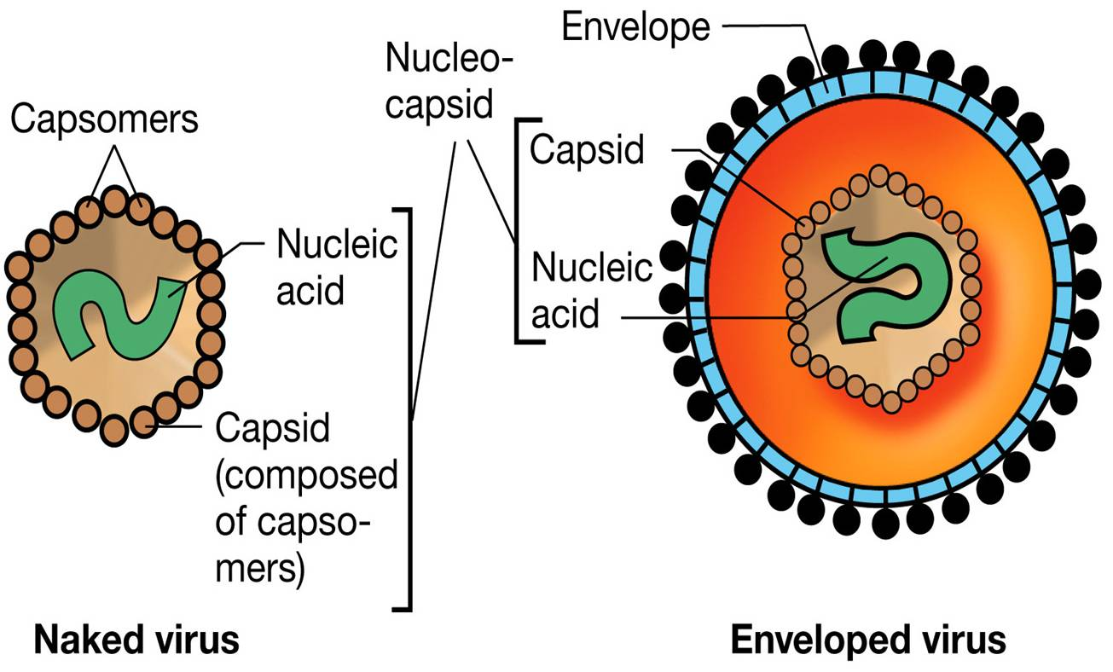
Viral Hepatitis
Classification:
Acute:
hepatitis A (HAV)
hepatitis B (HBV)
hepatitis C (HCV)
delta hepatitis (HDV)
hepatitis E (HEV) and
A sixth virus, hepatitis G (HGV) has emerged and is currently being investigated
Discrete date of onset
Rarely exceeds 6 months
a/w jaundice and AST/ ALT >2.5 x ULN
Chronic:
Inflammatory condition for more than 6 month
HBV, HCV and HDV are risk factors

Slide 2
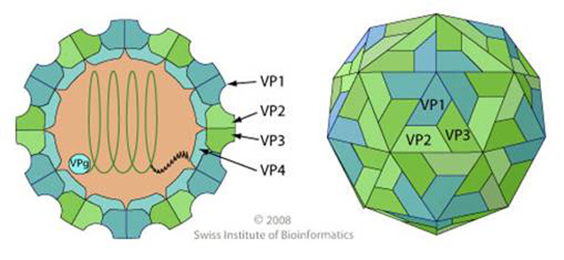
Hepatitis A virus (HAV)
Ingestion
Stomach
Small Intestine
Circulation
Small non-enveloped single stranded ribonucleic acid (RNA)
Humans are the only reservoir for the virus
Fecal-oral route
Others at risk include health care workers, IV drug users using unsterilized needles, food service handlers and those in health-care institutions
Liver/Hepatocytes
Replication
Degradation
Bile
Enterohepatic cycle will continue until antibody neutralization
Self limiting disease
No chronic liver disease has been associated with hep A
Elimination
Feces

Slide 3
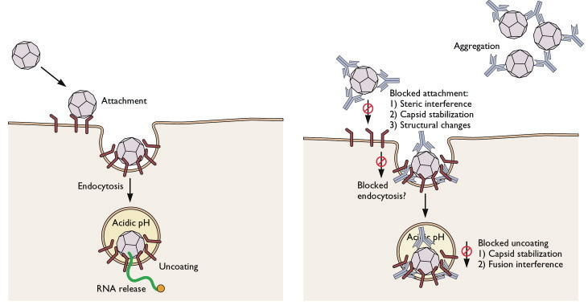
Antibody Neutralization

Slide 4
Serological Profile of HAV

Slide 5
Diagnosis
Diagnosis may be difficult because most patients are asymptomatic
Definitive test is the detection of immunoglobulin (Ig) antibody to the capsid proteins of HAV (anti-HAV) - IgM HAV antibody in serum about 3 weeks after exposure, levels become undetectable within 6 months
Management
Prophylaxis: - Hygiene & sanitation
- Pre-exposure prophylaxis: routine childhood immunization schedule for 1-2 yr old
- Post-exposure prophylaxis: recommended for those 2-40 yrs old who are immuno- competent
Vaccines:
- Hep A vaccine – VAQTA (preservative free) – HAVRIX
- Inactivated virus which provides active immunity & long term protection
- Serum immune globuline – IVIG
- From pooled human plasma
- Given IM for passive immunity by transfer antibodies against hep A
- Short term immunity for post-exposure prophylaxis
Treatment:
- NO specific TX b/c self-limiting disease – recovered within 10 wks
- Supportive

Slide 6
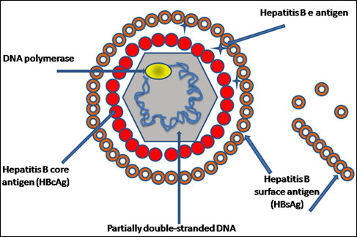
Hepatitis B Virus (HBV)

Slide 7
Transmission
- Spread by contact with blood, semen and other body fluids of an infected person
- Sexual, parenteral (IVDU) and perinatal transmission
Etiology
- HBV is the smallest known DNA virus
- It is a envelop, double stranded DNA virus
- This family of viruses replicate in the liver and cause hepatic dysfunction that can lead to chronic hepatitis, cirrhosis and hepatocellular carcinoma (HCC)
Pathophysiology
- HBV is not directly cytopathic; instead it is thought that the immune response to the virus is cytotoxic to hepatocytes.
- Cytotoxic T cell killing of infected cells occurs due to immunologic response to get rid of infected cells.
- Chronic HBV is a function of poor cytotoxic T cell response to viral antigens.
- Cirrhosis results as the liver attempts to regenerate while in an environment of persistent inflammation

Slide 8
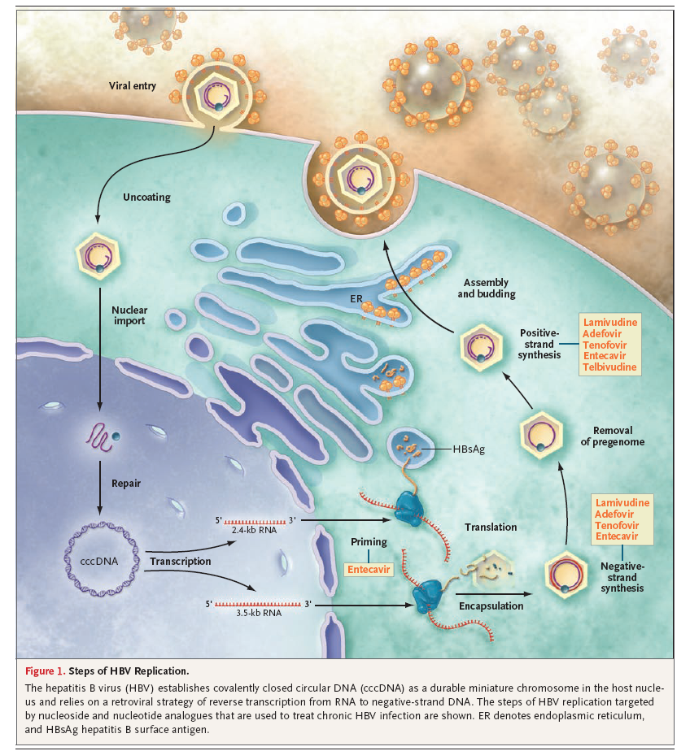
http://www.youtube.com/watch?v=sVpiXaEMs7I

Slide 9
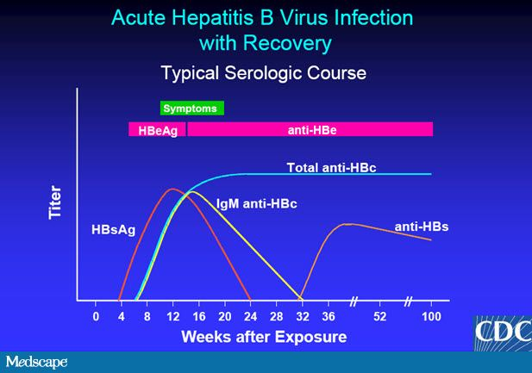

Slide 10
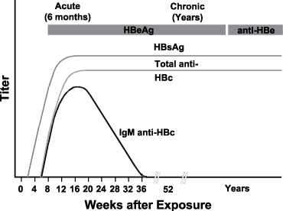

Slide 11
Interpretation of HBV Markers
HBsAg (Hepatitis B surface antigen) | First marker of active infection – Acute or chronic infection Chronic infection is indicated if levels persist >6 months
anti-HBs (Hepatitis B surface antibody) | Indicates recovery and immunity to HBV infection Absent in chronic infection. Positive in a person who has been successfully vaccinated against hepB
HBcAg (Hepatitis B core antigen) | Encloses the viral DNA and essential for viral packaging Not detectable in serum, only in liver tissue with acute or chronic HBV
anti-HBc (total Hepatitis B core antibody) | Found in acute and chronic carriers Utilized as a marker for past infection – Acute, chronic or resolved Also used as an antibody to distinguish between previous infection and vaccination Never appears in those vaccinated and almost always is present in previously infected individuals
HBeAg | Found in serum during acute and chronic hepatitis B Presence indicates viral replication – high level of virus Generally associated with a high degree of infectivity
Anti-HBe | Important in determining seroconversion – generation of antibodies
HBV DNA | Presence is a marker of viral replication and high infectivity Results can be qualitative or quantitative

Slide 12
Interpretation of HBV Markers
http://www.cdc.gov/hepatitis/hbv/hbvfaq.htm#C1
Test | 1 | 2 | 3 | 4 | 5 | 6
Surface-antigen | - | - | - | + | + | -
Surface-antibody | - | + | + | - | - | -
Core –antibody | - | + | - | + | + | +
IgM-Core-antibody |  |  |  | + | -
Susceptible
Immune due to natural infection
Immune due to Hepatitis B vaccination
Acutely infected
Chronically infected
Interpretation unclear; four possibilities
Resolved infection (most common)
False-positive anti-HBc, thus susceptible
"Low level" chronic infection
Resolving acute infection

Slide 13
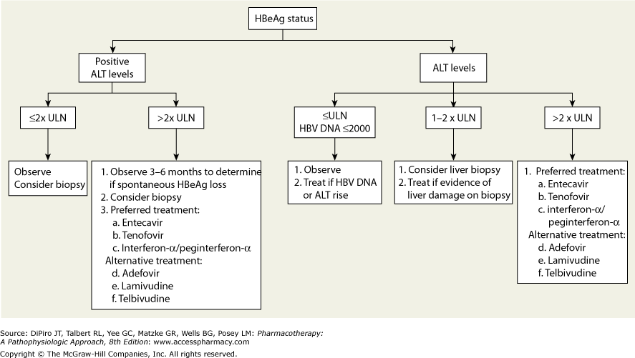
Treatment
Two modes of Tx:
Immunomodulation with IFN/pegylated interferon
Viral suppression nucleos(t)ide analogues
(lamivudine, adefovir, entecavir, telbivudine, tenofovir)

Slide 14
Comparison of Agents
Agents | Dose Adjust | Side Effects | Potency | Resistance
Interferon (SQ) | Weekly CBC for 1st 2 wk then monthly | Flu-like, fever, myalgia, ↓ WBC | Not recommended in decompensated ONLY for 1 yr TX | None
1st LINE
Entecavir | Minimal | GI upset | HIGH | Low
Tenofovir | Renal dose adj | GI upset | HIGH Can replace Adefovir | Unknown
2nd LINE
Adefovir | Renal dose adj | Nephrotoxicity Lactic acidosis | Least potent Slowest to suppress HBV | None @ 1 yr 30% @ 3 yrs
Telbivudine | Minimal | Myopathy Peri neuropathy | HIGH | High
3rd LINE
Lamivudine | Renal dose adj | N/V, HA Fatigue | Moderate | 15-30% @ 1 yr 70% @ 5 yrs

Slide 15
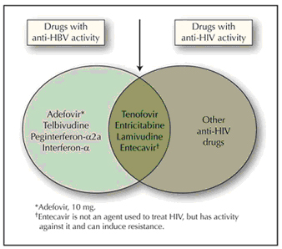
Future Tx options for Chronic HBV
Emtricitabine – nucleoside analog approved for Tx in HIV
Pradefovir to circumvent toxicity of Adefovir

Slide 16
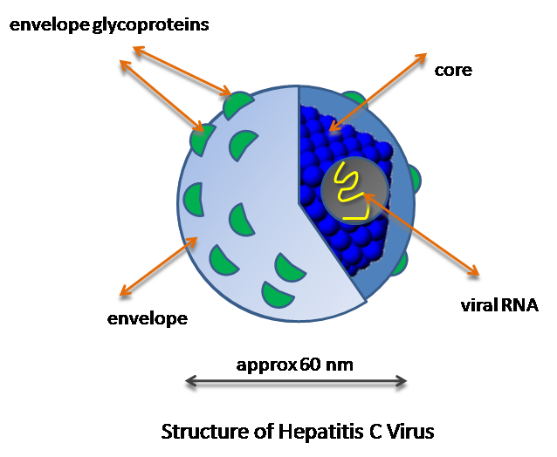
Capsid
> 85% of the cases develop into a chronic disease

Slide 17
Hepatitis C Virus
Transmission: Spread by blood to blood contact
Small positive strand RNA virus that almost exclusively infects hepatocytes
Poly-protein is processed by proteases into several polypeptides with different functional roles in the virus life cycle
The virus is replicated with the help of a polymerase and then assembled, transported and released from the cell.
Virus replicates in hepatocytes but is not directly cytopathic
Persistent infection is largely due to inadequate humoral and cellular response. This intermediate response is large enough to induce hepatic cell destruction and fibrosis but not enough to eradicate the virus from its reservoirs
Unlike HIV and HBV, the HCV genome is NOT maintained IN the host cell nucleus in any durable form, it only exists as a cytosolic RNA. Therefore clearance of infection from the cell without destruction of the cell should be possible.
The term “cure” is now used in patients with chronic hepatitis C who achieve a SVR and clear the virus.

Slide 18
Hepatitis C Virus
Virology
6 identifiable GENOTYPES
> 90 identifiable SUBTYPES a, b, c …
In the United States about 75% of those infected with HCV have either genotype 1, followed by 14% for genotype 2
Function of genotype is to determine the likelihood of therapeutic response.
Genotype 1 is most resistant to therapy
Patients with HCV infection are usually asymptomatic
Symptoms are usually nonspecific consisting of weight loss, anorexia, flu-like complaints, fatigue and abdominal pain

Slide 19
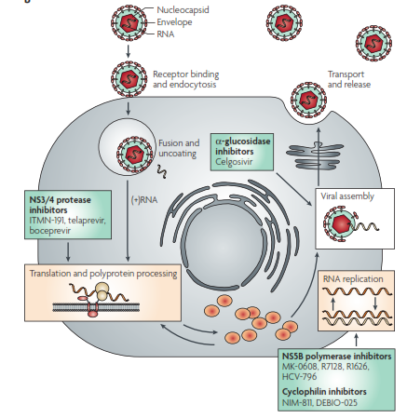

Slide 20
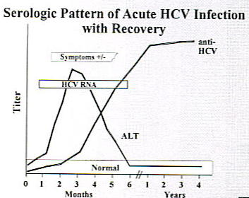
Indicate exposure -
RNA viral load to confirm chronic infection
> 15x ULN

Slide 21
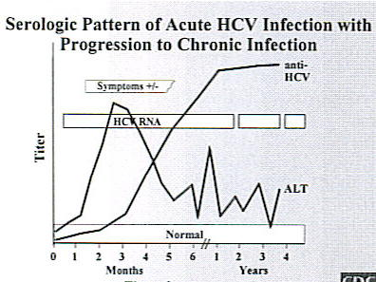
NO VACCINES AVAILABLE FOR PROPHYLAXIS

Slide 22
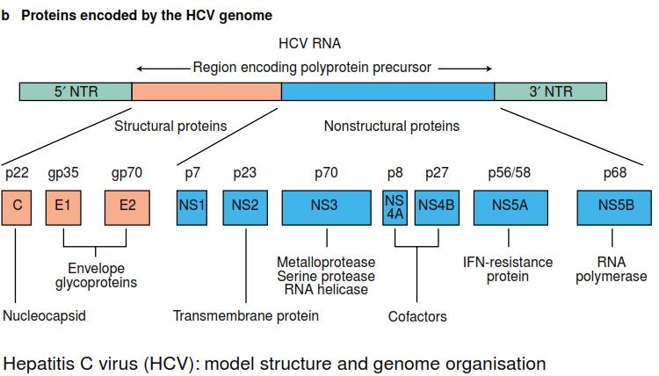
4 Classes of DIRECT ACTING ANTIVIRALS (DAAs)
Telaprevir
Boceprevir
Simepravir
Faldapravir
Sofosbuvir
Ledipasvir
Deleobuvir

Slide 23
Classification of Antiviral Drugs
Drug | Class | Side Effects
PEG-IFN | Cytokines | Flu-like Sx – Neutropenia – Thrombocytopenia – Psychiatric Contraindication: DECOMPENSATED LIVER Disease
Ribavirin | Nucleoside analog | Hemolytic anemia - Induce MI /stroke – Renal adj. PREGNANCY CATEGORY X
Telaprevir (TVR) | NS3/4A Protease Inhibitor | Anemia – Thrombocytopenia – Mild rash – Anorectal itching/burning
Boceprevir (BOC) | NS3/4A Protease Inhibitor | Anemia – Neutropenia – Thrombocytopenia - Dysgeusia
The serine protease NS3/4A is used by the HCV for post-translational processing and viral replication. Inhibitors of this protein may lead to rapid decline in HCV but cannot be used as monotherapy due to rapidly developing resistance.

Slide 24
Classification of Antiviral Drugs
Drug | Class | Comments
Simeprevir | NS3/4A Protease Inhibitor | approved 11/2013 In Triple-Tx for Genotype I
Sofosbuvir | NS5B Polymerase Inhibitor | approved 12/2013 – Triple Tx for Genotype 1-4 WITH NO IFN for Genotype 2,3 For Co-infected HCV & HIV
Faldaprevir | NS3/4A Protease Inhibitor | under investigation
Deleobuvir | NS5B - Non-nucleoside Inhibitor | under investigation
Ledipasvir | NS5A Inhibitors | under investigation
Simeprevir advantage: once daily oral agent and shorter duration of therapy than first generation NS3/4A inhibitors
Genotype 1 or 4: Sofosbuvir + PEG-IFN + ribavirin x 12 week
Genotype 2: Sofosbuvir + ribavirin x 12 weeks
Genotype 3: Sofosbuvir + ribavirin x 24 weeks

Slide 25
Drugs Interactions with Boceprevir and Telaprevir
Drug Class | Contraindication
Anticonvulsants | Carbamazepine, Phenobarbital, phenytoin
Antimycobacterials | Rifampin
Ergot derivatives | Dihydroergotamine, methylergonovine
Gi motility agents | Cisapride
HMG CoA reductase inhibitors | Lovastatin, simvastatin, atorvastatin
PDE5 inhibitor | Sildenafil, tadalafil
Sedatives | Triazolam, midazolam
Immunosuppressants | Cyclosporine, tacrolimus
Oral contraception | Ethinyl estradiol- decrease drug exposure. Two effective nonhormonal methods of contraception should be used

Slide 26
Treatment of HCV
Who should be treated?
- Patients seropositive for HCV (HCV RNA > 600IU/ml) with elevated ALT and inflammation/fibrosis on liver biopsy
Normal ALT does NOT exclude patients from treatment (ALT not reflective of severity of disease)
- Screening prior to treatment: cardiac evaluation, AFP (alfa fetal protein to rule out HCC – hepatocellular carcinoma), thyroid function tests.
Predictors of Favorable Response to Tx
Genotype 2 or 3
Low viral load (<1,000 IU/ml)
Age (<40 years)
Female gender
Normal body weight

Slide 27
Definition of Responses
Tx initiated
4 wks
12 wks
24 wks
Undetectable (RVR)
Undetectable (Complete EVR)
≥ 2-log ↓
(Partial EVR)
Detectable (Partial Responders)
< 2-log ↓
(NON Responders)
End of Tx
24 wks
Undetectable
(ETR)
Undetectable
(SVR)
Undetectable
(ETR)
Detectable
(Relapsers)

Slide 28
Different Tx Approaches
GENOTYPE 1
Standard Regimen (2002-2011) – Dual Drug Tx
- PEG-IFN (SQ) + Ribavirin (PO) for 48 wks
New Regimen (2011) – Triple Drug Tx with DIRECT ACTING ANTIVIRALS (DAAs)
- PEG-IFN + Ribavirin + Telaprevir (TVR) or Boceprevir (BOC) – Total: 12 wks
- PEG-IFN + Ribavirin – Total: 48 wks
GENOTYPE 2 & others
Standard Regimen (2002-2011) – Dual Drug Tx
- PEG-IFN (SQ) + Ribavirin (PO) for 24 wks
Response-Guided Tx
Futility rules
- HCV RNA < 25 IU/ml (undetectable) at wk 4; continue therapy with NS3/4A protease inhibitor
- If HCV detectable >25 IU/ml at wk 4 or any treatment week thereafter, stop all treatment
http://www.ncbi.nlm.nih.gov/pmc/articles/PMC3702221/

